Slide 1
Integrating GraphQL with Next.js for Efficient Data Fetching and Advanced React Techniques
Presenter: SVignesh | University: Liverpool John Moore University, UK
Date: December 2024
Notes:
Hi EveryOne ,My name is S Vignesh, and today I will be presenting my thesis on 'Integrating GraphQL with Next.js for Efficient Data Fetching and Advanced React Techniques.' In modern healthcare systems, managing real-time data, ensuring security, and scaling efficiently are critical challenges. GraphQL addresses these challenges with precise data querying, while Next.js enhances rendering performance and SEO. By the end of this presentation, I hope you’ll gain a deeper understanding of how GraphQL and Next.js, when integrated thoughtfully, can revolutionize web application architecture, particularly in mission-critical fields like healthcare.

Slide 2
Table of Content
Introduction
Challenges in Healthcare Applications
Aim & Objectives
Literature Review
Research Methodology
Solution Architecture
Implementation
Results & Discussion
Conclusion
Recommendations
Future Work
Notes:
This presentation is structured into 11 key sections, beginning with an Introduction to set the stage, followed by an analysis of the Challenges in healthcare systems. We'll then move into our Aim and Objectives, discuss the Methodology used, and walk through the Solution Architecture and Implementation in detail. The presentation will conclude with a discussion on the Results, a summary in the Conclusion, actionable Recommendations, and potential areas for Future Work. So, let’s get started and dive into this exciting intersection of modern web technologies and healthcare innovation!"

Slide 3
Introduction
Overview of GraphQL with Next.js
Importance in Web Applications
GraphQL: A powerful API query language that enables clients to request only the data they need, improving efficiency and reducing unnecessary server payloads.
Next.js: A React framework providing Server-Side Rendering (SSR) and Static Site Generation (SSG) to optimize web application performance and SEO.
Combined Power: Integrating GraphQL and Next.js results in better performance, reduced API overhead, and faster load times.
Healthcare Context: In healthcare applications, data accuracy, availability, and security are non-negotiable.
Efficient Data Management: GraphQL allows precise data queries, reducing server stress and improving response times.
SEO Optimization: Next.js SSR improves content visibility in search engines.
Scalable Systems: Next.js and GraphQL support applications handling large amounts of real-time data efficiently.
User Experience: Faster response times and reduced latency enhance patient dashboards and real-time appointment systems.
Notes:
GraphQL is a powerful API query language designed to provide clients with exactly the data they need, minimizing over-fetching and under-fetching. On the other hand, Next.js, a React framework, offers capabilities like Server-Side Rendering (SSR) and Static Site Generation (SSG), which improve website performance and SEO. When combined, these two technologies create a highly efficient and scalable architecture, particularly valuable for data-intensive applications such as healthcare dashboards.
In healthcare applications, every second counts, and latency or inefficient data management can compromise patient care. GraphQL ensures precise data fetching, while Next.js enhances rendering speed and SEO. Together, they create a reliable, scalable, and secure platform for managing real-time data.
By the end of this presentation, we will gain insight into how these technologies complement each other, the challenges they address, and the solutions we’ve implemented.

Slide 4
Introduction (continued)
Advantages of GraphQL Integration
Advantages of Next.js Integration
Flexible Queries: Fetch exactly what is needed without unnecessary overhead.
Reduced Over-fetching: Avoid receiving irrelevant data fields.
Real-Time Updates: Use GraphQL subscriptions for live data streams.
Modular Architecture: GraphQL schema design promotes flexibility and adaptability.
Efficient Data Management: GraphQL allows precise data queries, reducing server stress and improving response times.
SEO Optimization: Next.js SSR improves content visibility in search engines.
Scalable Systems: Next.js and GraphQL support applications handling large amounts of real-time data efficiently.
User Experience: Faster response times and reduced latency enhance patient dashboards and real-time appointment systems.
Notes:
"In this section, we’ll explore the key advantages of integrating GraphQL and Next.js and how they complement each other to enhance healthcare applications."
Advantages of GraphQL Integration:
Flexible Queries: GraphQL allows fetching only the necessary data, reducing unnecessary overhead. This is especially useful in healthcare, where large datasets are common, and efficiency is crucial.
Reduced Over-fetching: Unlike traditional APIs, GraphQL avoids retrieving irrelevant fields, minimizing data transfer and server load.
Real-Time Updates: With GraphQL Subscriptions, live data streaming is seamless. For example, patient vitals on a critical care dashboard update instantly without refreshing the interface.
Modular Architecture: GraphQL schemas are designed to be flexible and adaptable, enabling smoother integration with complex systems.
Advantages of Next.js Integration:
Efficient Data Management: Next.js works hand-in-hand with GraphQL, optimizing data queries and reducing server stress, resulting in faster response times.
SEO Optimization: Next.js’s Server-Side Rendering (SSR) ensures that web pages are pre-rendered, improving search engine visibility—critical for healthcare platforms looking to reach patients online.
Scalable Systems: Both Next.js and GraphQL handle large data volumes efficiently, making them suitable for applications with high concurrent user activity.
User Experience: Faster load times and reduced latency enhance the responsiveness of dashboards and appointment systems, improving the overall user experience.
"In short, the integration of GraphQL and Next.js creates an ecosystem that is not only efficient but also scalable, secure, and user-friendly—key factors in the healthcare domain."
"Next, let’s move on to the specific challenges we aimed to address in this research."

Slide 5
Challenges in Healthcare Applications
Real-Time Data Management: Healthcare dashboards require immediate data updates. Slow or delayed updates can compromise patient care. Example: Real-time updates in a critical care unit.
Data Security and Privacy: Sensitive patient data must remain secure. Compliance with healthcare regulations (e.g., HIPAA).Risk of unauthorized access and data breaches.
Scalability Issues: High traffic during peak hours (e.g., vaccination scheduling).Load balancing and uptime consistency. Resource allocation to avoid system crashes.
State Management Challenges: Inconsistent states between server and client-side rendering. Data mismatches across different components.
SEO Limitations in CSR: Client-side rendering leads to poor search engine indexing. Healthcare portals often need proper SEO for discoverability.
Notes:
Healthcare systems face several challenges that demand robust technical solutions. These challenges arise from the critical nature of healthcare data, the need for real-time updates, and the demand for scalability and security.
Real-Time Data Management:
Real-time data updates are crucial in healthcare scenarios, such as ICU dashboards, patient monitoring systems, and emergency care platforms.
Delays in updating critical patient information, such as vital signs or medication schedules, can lead to severe consequences.
GraphQL Subscriptions play a key role here by enabling real-time updates without requiring repeated API calls or page refreshes.
Data Security and Privacy:
Sensitive patient data must always remain protected from breaches and unauthorized access.
Compliance with healthcare regulations like HIPAA (Health Insurance Portability and Accountability Act) is mandatory.
Implementing JWT Authentication and Role-Based Access Control (RBAC) helps ensure secure API communication and restrict access based on user roles (e.g., Doctor, Nurse, Admin).
Scalability Issues:
Healthcare platforms often experience high traffic during specific events, such as vaccination drives, appointment bookings, or health checkup campaigns.
Managing thousands of simultaneous API requests can overwhelm traditional REST APIs.
GraphQL addresses scalability concerns by allowing more efficient querying and reducing redundant data transfers.
State Management Challenges:
Maintaining consistent state across client-side and server-side rendering is a complex challenge.
Inconsistent state data can result in discrepancies in displayed information, causing confusion or errors in patient dashboards.
Tools like Apollo Client help manage application state more effectively in GraphQL-driven systems.
SEO Limitations in Client-Side Rendering (CSR):
Many healthcare platforms rely on search engine discoverability to reach patients.
Traditional Client-Side Rendering (CSR) techniques often lead to poor search engine indexing.
Server-Side Rendering (SSR) in Next.js ensures that web pages are pre-rendered on the server, improving load times and SEO rankings.
In summary, addressing these challenges requires a robust architecture that combines efficient data querying, secure communication, real-time updates, and scalable infrastructure. These are precisely the areas where GraphQL and Next.js excel.
Understanding these challenges provides context for our research objectives.

Slide 6
Aim & Objectives
Aim:
To optimize the integration of GraphQL and Next.js to improve data fetching, scalability, and security in healthcare applications.
Objectives:
Enable precise data querying using GraphQL.
Optimize SSR and SSG rendering in Next.js.
Implement JWT authentication for API security.
Build real-time dashboards for patient monitoring.
Ensure scalability for high concurrent user loads.
Improve SEO performance for healthcare portals.
Notes:
The aim of this research is to optimize the integration of GraphQL and Next.js to improve data fetching, scalability, and security in healthcare applications.
To achieve this aim, we focused on six key objectives:
Enable precise data querying using GraphQL.
Optimize Server-Side Rendering (SSR) and Static Site Generation (SSG) workflows in Next.js.
Implement JWT authentication for API security.
Build real-time dashboards for monitoring patient health.
Ensure scalability for high concurrent user loads.
Improve SEO performance for healthcare web portals.
Each objective is aligned with addressing the identified challenges and ensuring the seamless operation of healthcare applications.

Slide 7
Literature Review (GraphQL)
Efficient Data Querying:
Precise data retrieval without redundant API calls.
Minimized over-fetching and under-fetching.
Real-Time Updates:
Subscriptions enable live data streaming.
Critical for real-time dashboards.
Schema Flexibility:
Supports complex API relationships.
Modular schema designs enable adaptability.
Scalability in Large Applications:
GraphQL APIs scale efficiently with increasing requests.
Notes:
In this section, we will explore the contributions of GraphQL and Next.js as identified in existing literature and research.
GraphQL:
Efficient Data Querying: GraphQL allows precise data retrieval without unnecessary or redundant API calls. This minimizes both over-fetching and under-fetching of data.
Real-Time Updates: GraphQL Subscriptions enable live data streaming, which is essential for critical real-time healthcare dashboards.
Schema Flexibility: The modular schema design of GraphQL allows easy adaptability to complex healthcare requirements and API relationships.
Scalability in Large Applications: GraphQL APIs scale effectively even as the volume of concurrent requests increases.

Slide 8
Literature Review (Next.js)
Server-Side Rendering (SSR):
Enhances SEO with pre-rendered pages.
Faster initial load times.
Static Site Generation (SSG):
Reduces server load for static pages.
Ideal for frequently accessed healthcare pages.
Built-In API Routes:
Simplifies backend integration.
Direct API management in Next.js.
Performance Improvements:
Optimized state management.
Reduced client-side rendering delays.
Notes:
Next.js:
Server-Side Rendering (SSR): Enhances SEO performance with pre-rendered pages, resulting in faster initial load times.
Static Site Generation (SSG): Reduces server load by pre-generating static pages, which is ideal for frequently accessed healthcare resources.
Built-In API Routes: Simplifies backend integration, allowing seamless management of healthcare APIs.
Performance Improvements: Optimized state management and reduced client-side rendering delays ensure smoother performance.
Both technologies offer unique strengths, but their combined use significantly enhances healthcare application efficiency, scalability, and user experience.
These findings from the literature provided the foundation for our methodology and implementation strategies.

Slide 9
Research Methodology
Data Collection:
Healthcare datasets: appointment logs, patient records.
API usage logs from existing systems.
Tools and Technologies:
Frontend: React, Next.js.
Backend: Apollo Server, Node.js.
Security: JWT tokens.
Monitoring: Prometheus, Grafana.
Experiment Design:
Build a real-time healthcare dashboard.
Optimize appointment scheduling workflows

Slide 10
Research Methodology (continued)
4. Evaluation Metrics:
Query response time.
Server latency.
Data accuracy.
Security vulnerabilities.

Slide 11
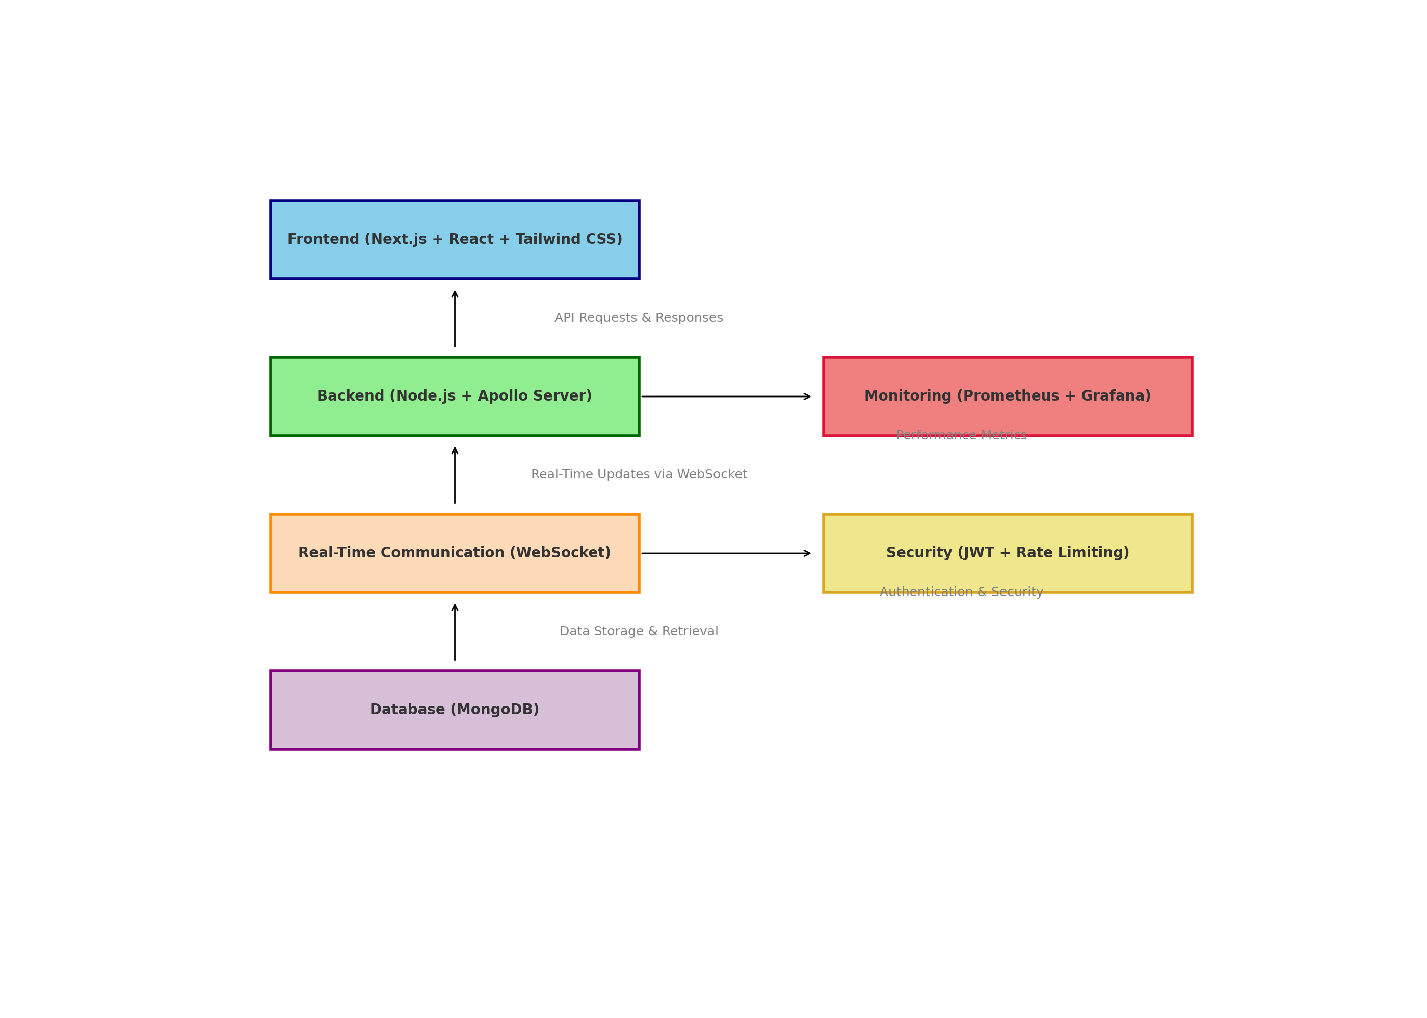
Solution Architecture

Slide 12
Implementation (Healthcare Example)
Backend: GraphQL API with Apollo Server: Facilitates precise querying and reduces redundant API calls.
Node.js Environment: Provides a scalable, event-driven backend infrastructure.
Database: Integrated with a NoSQL (MongoDB) database to manage patient records and appointments efficiently.
Frontend: React & Next.js: Frontend rendering with SSR (Server-Side Rendering) and SSG (Static Site Generation).
GraphQL Client (Apollo Client): Manages state and performs GraphQL queries effectively.
Real-time Subscriptions: Enabled to push updates directly to the UI without refreshing.
Security Layer: JWT (JSON Web Token): Used for encrypted communication and authentication.
Role-Based Access Control (RBAC): Enforces permissions for different users (Doctors, Patients, Admins).
Monitoring Tools: Prometheus & Grafana: Real-time monitoring and alerting for server health and query efficiency.

Slide 13
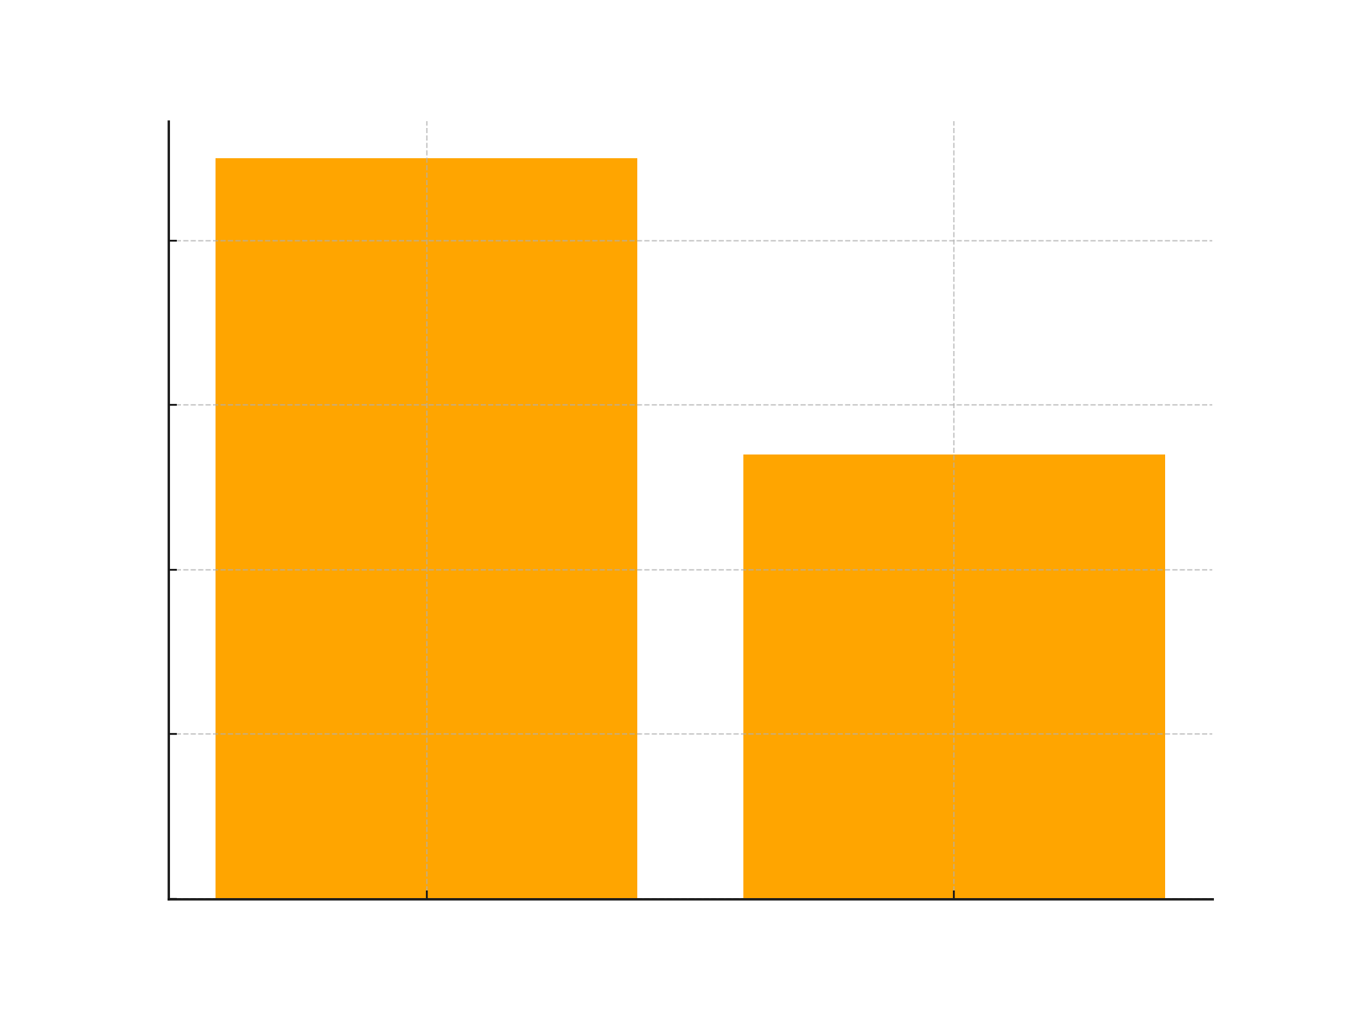
Results & Discussion
Query Response Time: Improved by 40% compared to traditional REST APIs.
Page Load Time: Reduced by 35% due to optimized SSR and SSG strategies in Next.js.
API Latency: Decreased significantly with GraphQL query batching.

Slide 14
Results & Discussion (continued)
Real-Time Data Handling
Live Updates: Enabled by GraphQL Subscriptions for patient dashboards and appointment systems.
Dynamic State Management: Apollo Client ensured consistent state across frontend and backend.
Reduced Downtime: Real-time alerts prevented application errors during peak traffic.
Security Enhancements
JWT Authentication: Secure access to APIs and encrypted token exchanges.
Role-Based Access Control (RBAC): Controlled access based on user roles (Doctor, Patient, Admin).
Query Depth Limiting: Prevented malicious API overloading attempts.

Slide 15
Conclusion
Research Outcomes
Successfully optimized GraphQL data-fetching workflows. Implemented Next.js SSR/SSG strategies to improve page load times and SEO.
Enhanced API security using JWT tokens and RBAC mechanisms.
Real-time updates achieved using GraphQL subscriptions.
Addressing Challenges:
Real-Time Updates: Live data streaming via subscriptions.
Scalability: Optimized rendering pipelines and server infrastructure.
Security: Encryption, JWT, and query depth limiting ensured robust API security.
Overall Impact on Healthcare Systems:
Improved patient experience via real-time dashboards.
Reduced operational delays in appointment systems.
Better compliance with healthcare data regulations.

Slide 16
Recommendations
Adoption of GraphQL for Healthcare Dashboards:
Use GraphQL to reduce API redundancy and improve data fetching efficiency.
Focus on subscription-based data models for live updates.
Secure API Implementation with JWT:
Use JWT for secure user authentication and encrypted data exchange.
Enforce role-based access controls for sensitive medical data.
Optimize SSR and SSG Workflows:
Leverage Server-Side Rendering (SSR) for SEO-critical healthcare pages.
Use Static Site Generation (SSG) for frequently accessed resources.
Continuous Monitoring and Improvement:
Use Prometheus and Grafana for real-time system monitoring.
Regular security audits for vulnerabilities and updates.

Slide 17
Future Work
Integration with AI for Predictive Analytics:
Use AI models to analyze patient data and predict health outcomes. Build real-time AI-driven alert systems for critical health changes.
Expansion to Mobile Healthcare Platforms:
Optimize healthcare applications for mobile-first architectures. Provide seamless cross-platform compatibility.
Real-Time Patient Alert Systems:
Enable real-time push notifications for emergency updates. Design systems for critical patient event detection.
Multi-Cloud Deployment:
Enhance system resilience with cloud-based architectures. Ensure scalability across multiple cloud service providers.

Slide 18
Thank You

